Slide 1
Watson Assistant + Spotify +APIs
Session 3

Slide 2
Stuff to cover
What is an API and different types of APIs
HTTP Methods and Status Codes
Benefits of API
Architecture of API and backend
Examples of APIs in use
Authentication
OpenAPI
What we will be doing

Slide 3
What is an API?
API stands for application programming interface, which is a set of definitions and protocols for building and integrating application software.
This would be a gateway for developers to connect to other products easily through request methods and integrating it with their product.
It could also be a lightweight method for users to use a product.

Slide 4
HTTP Methods and Status Codes
Here are some commonly used HTTP Methods and Status Codes:
Method | Action
GET | Retrieves resources
POST | Creates resources
PUT | Changes and/or replaces resources or collections
DELETE | Changes and/or replaces resources or collections
Status Code | Explain
201 | Successful Created
401 | Unauthorized access
403 | Understands request but refuses to authorize it
429 | Too Many Requests

Slide 5
Benefits of API
Some benefits of API are:
Low resource utilization
Process instances are explicitly created
The developer does not need routing information with the initial URI
Allowing users to connect to service without needing to independently create a path

Slide 6
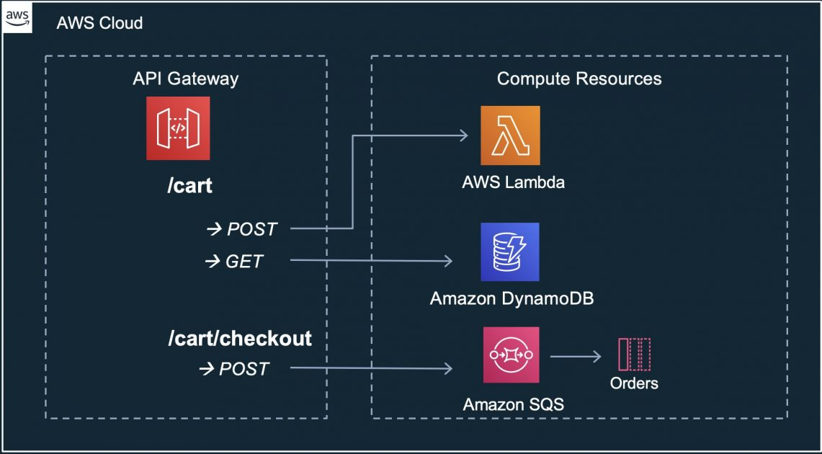
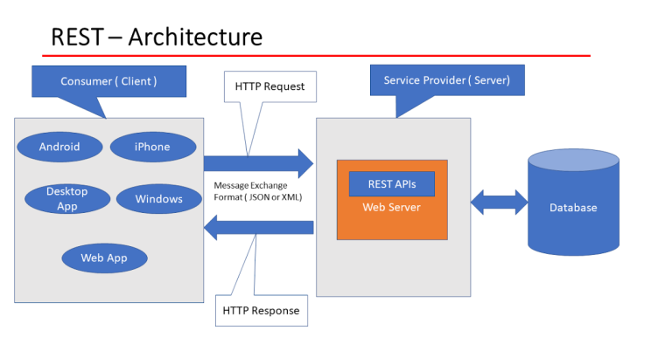
Architecture of API and backend

Slide 7
Examples of API in use
Live chatbots
Maps
Satellite Imagery
Custom social network clients
Trading Apps

Slide 8
Authentication
There are numerous types of authentication APIs but here are some common ones:
OAuth
Bearer Token
API Key
HTTP Username and Password

Slide 9
OpenAPI
OpenAPI is a specification for describing, producing, consuming and visualizing REST APIs. It is used by many large companies such as Google, IBM, Bloomberg, and Microsoft.
This has simplified how APIs are expressed and viewed as you can simply execute APIs calls without needing to cURL or create a script to do a simple API call.

Slide 10
What we will be doing
Today, we will be creating a custom extension using a JSON file to connect with Watson Assistant. I will show how to create a token, upload the file, and create a new playlist.
I will provide a file as a foundation and example on how to connect an API using OpenAPI.

Slide 11
Optional Homework
There is optional homework. Please look at the link below and decide what feature you would like to use with the VA.
Here are some examples:
Skipping next song
Playing from playlist
Pausing and Playing songs
Recommendations

Slide 12
Any Questions

